Slide 1

RNA viruses and Varroa mites: How does temporal variation influence patterns of co-infection?
P. Alexander Burnham
University of Vermont, Department of Biology

Slide 2


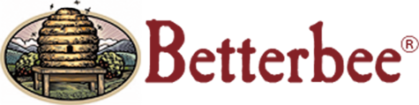
Acknowledgments
Co-Authors:
Samantha Alger
Leif Richardson
Advisors:
Dr. Alison Brody
Dr. Nick Gotelli
Thank You:
Dr. Joseph Schall
Jeff Lee, Lees Bees, Mebane, NC
Kendall Eppley
Greer Sargeant
Nora Keathley
Gracia Archeson

Slide 3
And Most of all, our Backers…
VT Beekeepers Association, NH Beekeepers Association, Edward Alger, Betterbee, Bailey Bee Supply, Charles M Edens, Lee Trainer, David Tremblay, Robert Merkert, Tina Sekimi, Mike Kiernan, Sandra Tomlinson, Amy Handy, Joe Perry, Luke Manlove, Dan Boisvert, Jacqueline Alger, Dan O'Hanlon, Patrick Gillen, Alison K Brody,Daniel Hall Lipke, Beth Sawyer, Cathy Wilson, Allison Malloy, Richard Reid, Nicole Berthiaume, Heather Achilles, Phyllis E Burnham, Yeager Anderson, Bill Castro, Luke Tilley,Jonathan Alger, Peter Gatehouse, Amy Parachnowitsch, Trevor Brandt, Katie Iles, JESSICA PAGANO, Kate Protagonist, Andrea Stanley, Robert Zywno, Helmut Besser, Allen Turechek,Adrian Adam Zywno, Kirsten Shoshanna Traynor, Meghan O'Rourke, Jean McCartin, Ben Ritchie, Vicki Anne, Hollis Woodard, James DeRosia, The Backyard Farm, Malcolm Hobbs,Aaron Schwartz, Linda Battista, Lauren Ash, Raphaël Royauté, Kay Newhouse, Maggie Davern, Joanne Bryan, Sarah Rommelfanger, Pureum Kim, Luke McCartin, Kendall Johnson,Sara Held, Eric Damon Walters, and Bo Sprotte Kofod

Slide 4
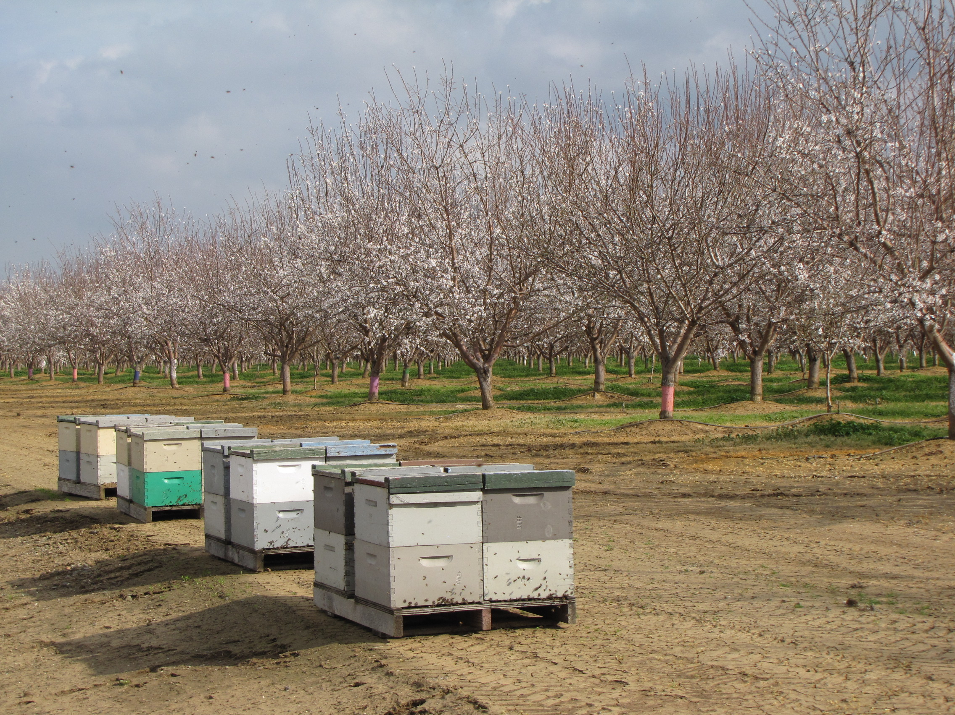
Bees are Important
- 30% of the world’s food is derived from pollination
_{Aizen et al., 2009}
- Pollinators are responsible for between $235-577 billion
^{Gallai et al., 2009}
- Honeybees are responsible for $14 Billion in the USA
^{Morse and Calderone, 2000}

Slide 5
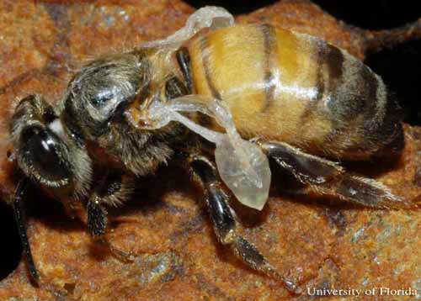
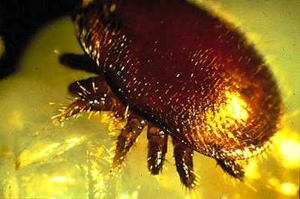
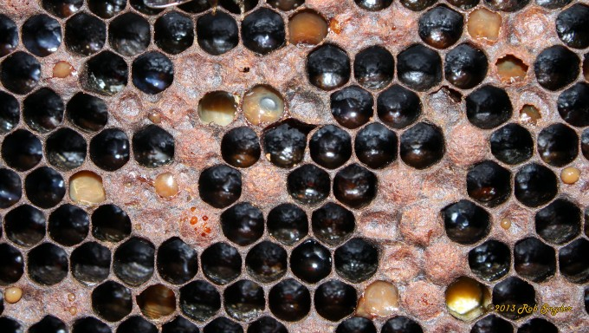
Honey Bee Pathogens:
VIRUSES:
Deformed Wing Virus (DWV)
Black Queen Cell Virus (BQCV)
Israeli Acute Paralysis Virus (IAPV)
PARASITES:
Nosema (ceranae, bombi & apis)
Varroa Mite
OTHER PATHOGENS & Pests:
American Foulbrood (AFB)
European Foulbrood (EFB)
Chalk Brood
Small Hive Beetle
Deformed wing Virus
University of Florida,
Entomology Dept.
Varroa destructor
North Carolina State University,
Cooperative Extension
American Foulbrood
Bee Informed Partnership

Slide 6
Disease Ecology:
Ecology: the study of organisms interacting with each other and their environment
Negative Interactions:
Competition
Predation
Parasitism
Positive Interactions:
Mutualism
Commensalism
Sinaur, Ecology 3rd Ed.

Slide 7
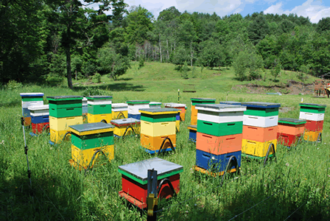
Bees and Epidemiology:
Time Magazine
West Meadow Bees

Slide 8
Bees and Epidemiology:
Time Magazine
West Meadow Bees

Slide 9
Bees and Epidemiology:
Time Magazine
Fox Cities Magazine
West Meadow Bees

Slide 10
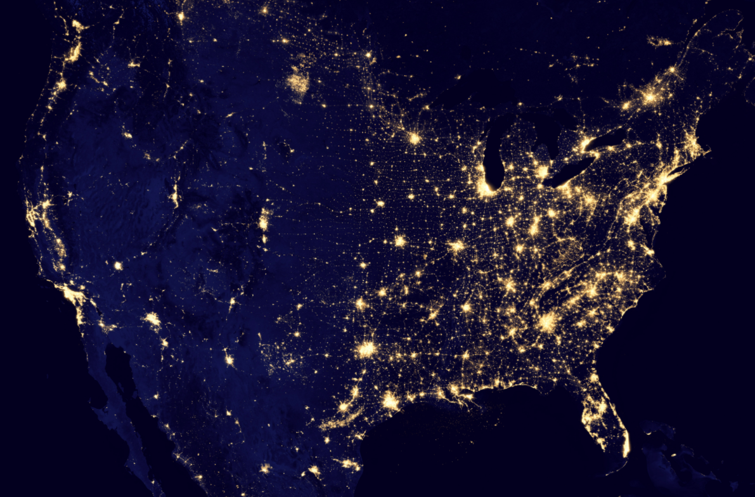
Bees and Epidemiology:
Time Magazine
Fox Cities Magazine
West Meadow Bees
NASA

Slide 11
My main questions:
How do these pathogens disseminate throughout the environment?
What are the drivers behind co-infection?
How do pathogens interact with each other (organismal interactions) and their host (environment)?

Slide 12
Why does this matter?
This community ecology approach to disease research is under-utilized (Johnson et al., 2016)
Co-infection is understudied in many disease systems (Rigaud et al., 2010 )
Co-infection has been shown to lead to unhealthy bees (Cox-Foster et al., 2007)

Slide 13
My Dissertation:

Slide 14
My Dissertation:
Chapter I – Survey of Nosema in Vermont Bumble bees - parameterize a epidemiological model

Slide 15
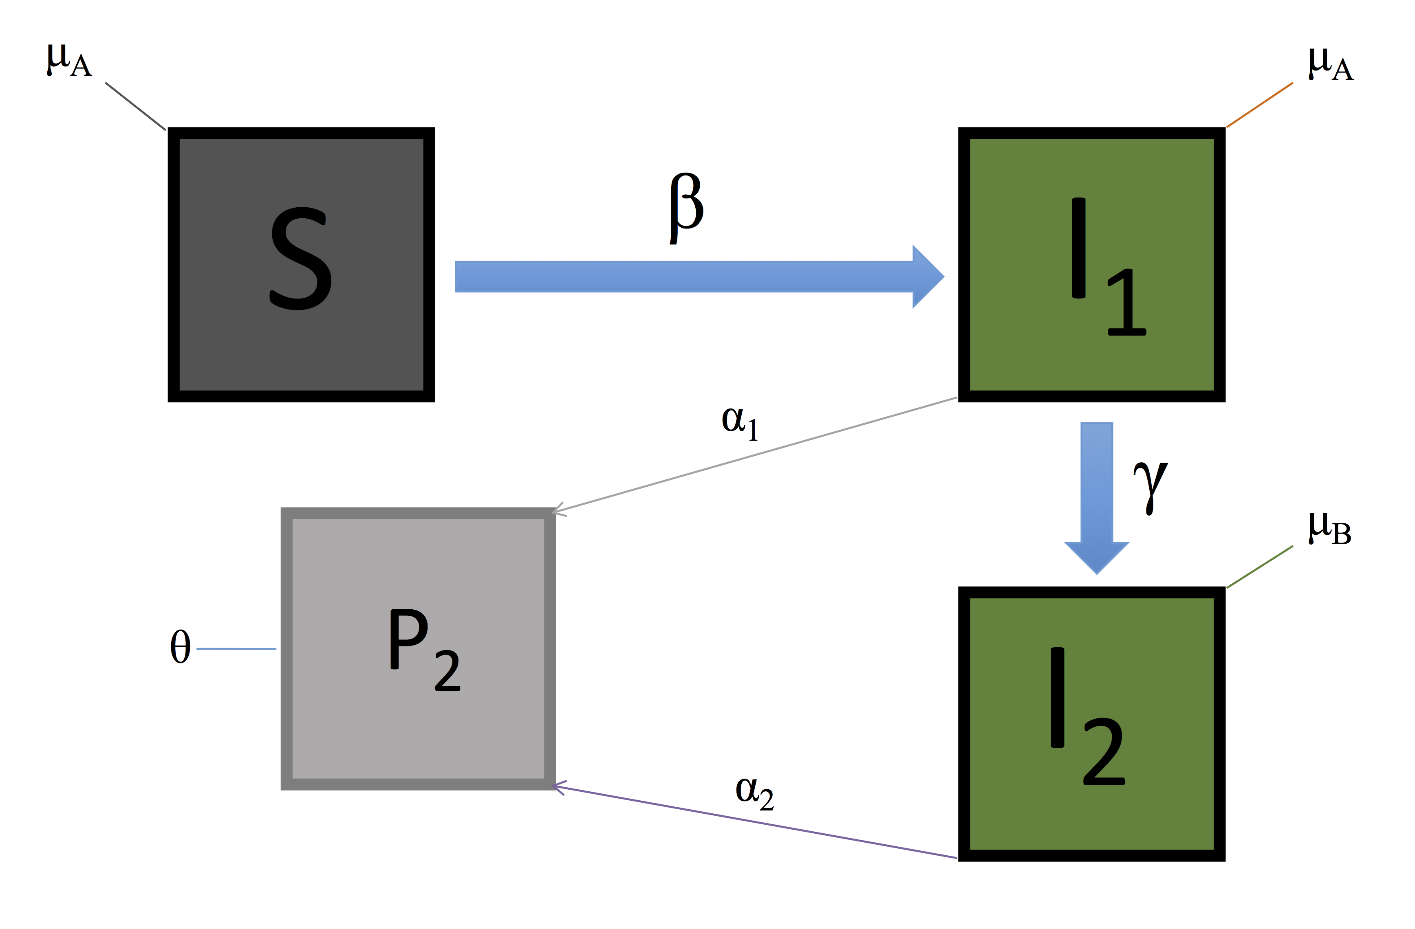
My Dissertation:
Chapter I – Survey of Nosema in Vermont Bumble bees - parameterize a epidemiological model

Slide 16
My Dissertation:
Chapter I – Survey of Nosema in Vermont Bumble bees - parameterize a epidemiological model

Slide 17
My Dissertation:
Chapter I – Survey of Nosema in Vermont Bumble bees - parameterize a epidemiological model
Chapter II – Survey of Apis and Bombus pathogens through time to model patterns of co-infection

Slide 18
My Dissertation:
Chapter I – Survey of Nosema in Vermont Bumble bees - parameterize a epidemiological model
Chapter II – Survey of Apis and Bombus pathogens through time to model patterns of co-infection
Chapter III – Lab inoculation experiments for RNA viruses and Nosema spp. in Bumble bees.

Slide 19
My Dissertation:
Chapter II – Survey of Apis and Bombus pathogens through time to model patterns of co-infection

Slide 20
My Dissertation:
Chapter II – Survey of Apis and Bombus pathogens through time to model patterns of co-infection

Slide 21
The questions of this study:
How does temporal variation affect co-infection?
Is their evidence for keystone pathogens that help drive co-infection?
Temporal Variation
Co-infection
Keystone Pathogen

Slide 22
The questions of this study:
How does temporal variation affect co-infection?
Is their evidence for keystone pathogens that help drive co-infection?
Temporal Variation
Decreased
Health
Co-infection
Keystone Pathogen

Slide 23
Methods

Slide 24
Experimental Design:
3 yards in North Carolina
Samples taken at 3 time point every 4 weeks
Sample size: N1=32, N2=32, N3=16

Slide 25
We sampled for:
Growth:
Brood Pattern (queen quality)
Frames of Bees (colony size)
Pathogens:
Varroa Mites
Nosema spp.
DWV (Deformed Wing Virus)
BQCV (Black Queen Cell Virus)

Slide 26
Results

Slide 27
Varroa & Nosema Load
DWV & BQCV Load

Slide 28
Pathogen Prevalence Through Time

Slide 29
Pathogen Prevalence Through Time

Slide 30
Pathogen Richness for Each Sampling Event
P < 0.0001

Slide 31
Varroa Load Predicts Pathogen Richness
p < 0.0001

Slide 32
Varroa Load by BQCV for Each Sampling Event
p = 0.036

Slide 33
Varroa Load by BQCV
p = 0.024

Slide 34
In Summary
Pathogens can change drastically in prevalence and load through time (Temporal Variation)
Pathogens like Varroa (Keystone Pathogens) have some influence over the entire pathogen community as a whole
Monitoring and Managing these treatable pathogens can help lower overall pathogen load and species richness

Slide 35
Future Work

Slide 36
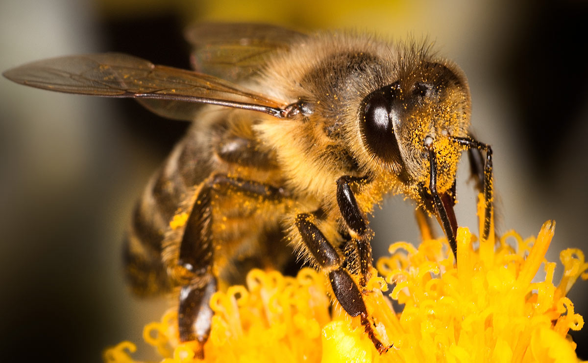
Thank You!

Slide 37
Questions?

Slide 38
Varroa Load (before and after formic acid)

Slide 39
Disease Prevalence & Population Metrics through Time

Slide 40
Varroa Prevalence Predicts Pathogen Richness
p < 0.0001

Slide 41
What am I interested in:
Temporal Variation – how pathogens fluctuate in prevalence or load through time
Keystone Pathogen – pathogen or parasite who’s presence has a significant effect on the community composition as a whole
Co-infection – multiple infections (pathogens) occurring simultaneously in the host

Slide 42
Population Measures for Each Sampling Event

